Slide 1
MODULE 5 New Methods & Practices
5.2 The Future of VET. Entrepreneurship Competence in VET

Slide 2
TRENDS IN VET IN EUROPE
Mega drivers and how change happens in VET
The Pendulum Effect
Notes:
Research shows that the development of VET does not follow an unbroken chain of developments leading in one direction but can be interrupted by changes of course in policy and practice, economic social and educational goals. Recent events such as the COVID-19 pandemic, the war in Ukraine, the energy crisis and surging inflation confirm the validity of this perspective.

Slide 3
One area where a pendulum effect is clearly observable is assessment.
A strong emphasis on summative assessment (with a focus on certification)
An increasing focus on standardized and external assessments (to ensure high levels of reliability), as well as an increasing use of competence demonstrations in the workplace (to ensure authenticity and validity of assessment)
Both developments are often regarded as a way of strengthening the image and value of VET.
Notes:
Whereas traditionally there has been a strong emphasis on summative assessment (with a focus on certification), we can also see an expansion of assessment functions and a strengthening of formative assessment with a focus on learning support. In addition, we can also observe an increasing focus on standardized and external assessments (to ensure high levels of reliability), as well as an increasing use of competence demonstrations in the workplace (to ensure authenticity and validity of assessment). Both developments are often justified in policy as a way of strengthening the image and value of VET.

Slide 4
Changing course in VET can be compared to trying to change the course of a supertanker!
Notes:
Changing course in VET, as in education in general, can be compared to trying to change the course of a supertanker: it takes so long to turn around that by the time a new direction is taken, the weather conditions (drivers) may have changed. In addition, changes in VET may be a consequence of developments in other education sectors. For example, both the strengthening of standardized and external forms of assessment can be seen as a measure to raise the status of VET and thus expand the possibilities of access to higher education.

Slide 5
OTHER TRENDS IN VET
Fewer and broader IVET qualifications with strengthened general education components and transversal skills and competences.
Increasing diversification of VET provision
Notes:
The number of VET schools has decreased in many countries, either due to demographic trends and/or to an increased efficiency and effectiveness of provision (by merging schools). Hybrid education and hybrid schools are becoming more common.
Despite the fall in VET schools numbers, we are seeing a diversification of VET provision, not only through greater autonomy in the curriculum, but also in terms of learning sites and an increase in workplace learning.

Slide 6
It remains to be seen how increases in general education and transverse skills content and workplace learning will develop and what the consequences will be. Both represent attempts to increase the attractiveness and quality of VET, and the commitment to tackling the skills gap in the labour market.

Slide 7
What skills & competences are needed to tackle those challenges?
Resilience
Flexibility
Adaptability
Acting upon opportunities and ideas
Notes:
Modern society is changing rapidly the way we live, work and learn. Technological developments, climate change, demography, various crises, require adapting to new realities. To manage these changes, we need the right skills and competences. Resilience, flexibility, adaptability, acting upon opportunities and ideas are just some elements of entrepreneurship competence, a key competence for all.

Slide 8
European cooperation in VET has an important role in promoting entrepreneurship competence.
The European skills agenda for sustainable competitiveness, social fairness and resilience (2020) stressed the importance of fostering entrepreneurial and transversal skills.
The Council Recommendation on VET for sustainable competitiveness, social fairness and resilience calls for adapting and expanding VET by supporting the acquisition of entrepreneurial skills together with digital and green skills.

Slide 9
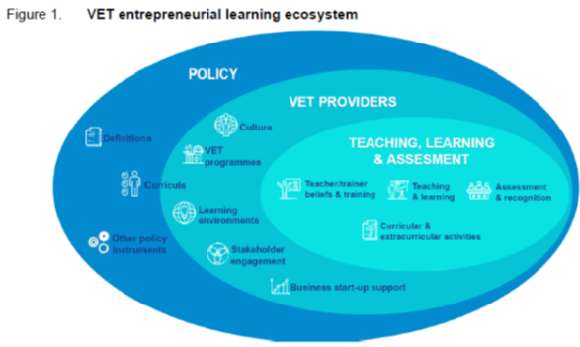
Research shows that VET plays a crucial role in promoting entrepreneurship competence. Efforts have been made in Europe to establish VET entrepreneurial learning ecosystem, although there is still a need for improved links between the ecosystem components and collaboration among stakeholders
Notes:
Responding to these priorities, CEDEFOP carried out a study to provide VET stakeholders with new evidence on how entrepreneurship competence is embedded in VET.
This research shows that VET plays a crucial role in promoting entrepreneurship competence. Efforts have been made in Europe to establish VET entrepreneurial learning ecosystem, although there is still a need for improved links between the ecosystem components and collaboration among stakeholders
VET entrepreneurial learning ecosystem – A learning community to promote and embed entrepreneurship competence through various activities and initiatives led by VET providers and implemented with the commitment of teaching staff in collaboration with a range of external stakeholders. The entrepreneurship learning ecosystem encompasses the organizations and individuals involved, the interactions taking place internally and externally, and the resources available within a given policy environment. The VET provider is in the centre due to its crucial role in developing entrepreneurial attitudes, aspirations and activity.

Slide 10
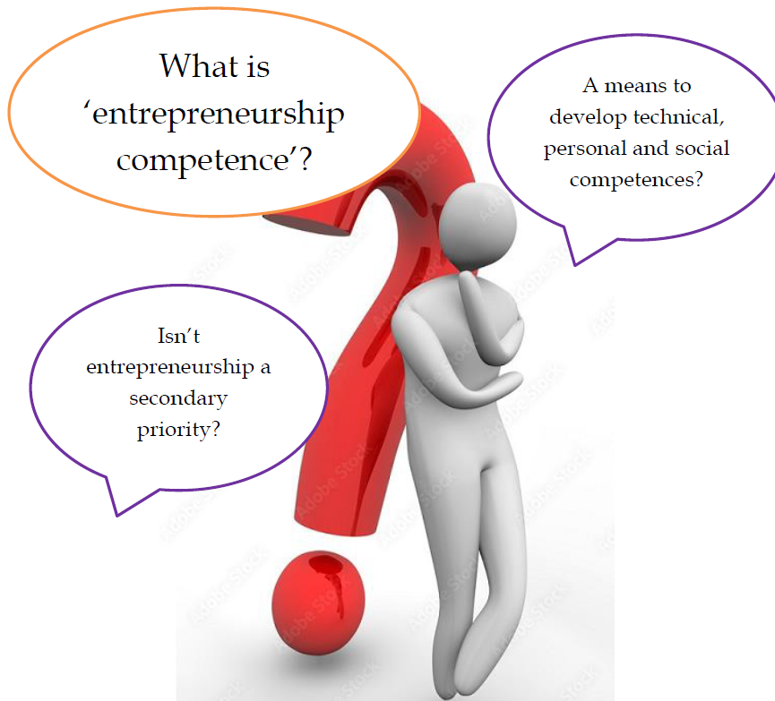
Understanding the Competence
Notes:
VET teachers have mixed feelings about the nature and definition of entrepreneurship. Some see it as a means to develop technical, personal and social competences that enhance VET learner professional profiles, employability, and future career prospects. Others seem to be confused by definitions or consider entrepreneurship as secondary priority. Teachers stress that transversal skills like literacy, numeracy, socio-emotional and technical, should precede the development of entrepreneurship competence. The term ‘entrepreneurship’ carries ideological connotations and biases that sometimes result in VET teachers, trainers and management avoiding its use.

Slide 11
Entrepreneurial and financial skills and competences are defined within the ‘Life skills and competences’ cluster as abilities to process and utilize knowledge and information with wide-ranging implications, fostering active citizenship and personal/professional growth.
Notes:
A recent report to ESCO (European Skills, Competences, Qualifications and Occupations) working group on terminology for transversal skills and competences (Hart et al., 2021) categorized skills and competences into six broad groups: core skills, physical and manual, thinking, self-management, social and communication, and life skills and competences. Entrepreneurial and financial skills and competences are defined within the ‘Life skills and competences’ cluster as abilities to process and utilize knowledge and information with wide-ranging implications, fostering active citizenship and personal/professional growth.

Slide 12
THE COURSE IN ENTREPRENEURSHIP
Entrepreneurship – a mindset, opportunity-focused and creative:
creating value for customers and investors,
gaining independence in your career, taking bold risks,
solving challenges with undefined solutions.
Notes:
Entrepreneurship is a mindset – a way of looking at things that is opportunity-focused and creative. It is about creating value for customers and investors, gaining independence in your career, taking bold risks, and solving challenges with undefined solutions.

Slide 13
THE COURSE IN ENTREPRENEURSHIP
To be an entrepreneur, you need, among other skills:
Ability to innovate,
Passion,
Persistence.
Notes:
To be an entrepreneur, you need to have the ability to innovate – to improve the old and invent the new. You need passion – and love what you are doing. Above all, you need persistence – getting up every day and moving forward with no one telling you what to do and why to do it.

Slide 14
THE COURSE IN ENTREPRENEURSHIP
The course should provide an introduction to, and an overview of the fundamentals of entrepreneurship. Whether trainers already have an idea and are eager to start their own business, or simply want to learn more about what an entrepreneurial career would be like, the course should expose them to the challenges of entrepreneurship – from conceptualizing new ventures to developing and managing them.

Slide 15
THE COURSE IN ENTREPRENEURSHIP
Sample Course Outline:
idea generation,
opportunity recognition and early opportunity development,
testing and adapting a business concept,
evaluating go-to-market strategies,
developing a business model,
financing the venture to get off the ground,
how an entrepreneurial mindset can aid alternative career paths
Notes:
You may start with idea generation, opportunity recognition and early opportunity development, with emphasis placed on understanding the mechanisms by which entrepreneurs determine if a specific business concept merits the in-depth feasibility assessment appropriate to opportunity pursuit. Then you could progress to topics, such as testing and adapting a business concept, evaluating go-to-market strategies, developing a business model, and financing the venture to get off the ground. You should also explore how an entrepreneurial mindset can aid alternative career paths, such as corporate entrepreneurship and social entrepreneurship.

Slide 16
THE COURSE IN ENTREPRENEURSHIP
Learning Objectives:
By the end of the course, trainees will be able to:
Explain fundamental concepts, theories and practices employed in the field of entrepreneurship and the role entrepreneurship plays in the global economy and society;
Describe the new venture creation process – including the activities, challenges and opportunities involved;
Evaluate new venture opportunities to determine their strengths, weaknesses, and overall business potential.
Notes:
Learning Objectives
In this course, trainees should develop their conceptual and practical knowledge of new venture creation and management.
By the end of the course, trainees will be able to:
Explain fundamental concepts, theories and practices employed in the field of entrepreneurship and the role entrepreneurship plays in the global economy and society;
Describe the new venture creation process – including the activities, challenges and opportunities involved;
Evaluate new venture opportunities to determine their strengths, weaknesses, and overall business potential.

Slide 17
THE COURSE IN ENTREPRENEURSHIP
During the course, trainees will also:
Develop their leadership skills, particularly in the areas of team leadership and entrepreneurial leadership;
Improve their oral and written communication skills (by learning to craft an effective concept statement, develop an in-depth industry analysis, and deliver a persuasive business pitch).
Notes:
During the course, trainees will also:
Develop their leadership skills, particularly in the areas of team leadership and entrepreneurial leadership;
Improve their oral and written communication skills (by learning to craft an effective concept statement, develop an in-depth industry analysis, and deliver a persuasive business pitch).

Slide 18
MODULE 5 New Methods & Practices
THANK YOU!
Notes:
A sample lesson plan is provided as an additional material. This sample lesson plan is from a guide developed by the Shark Tank
Shark Tank is an American business reality television series that premiered on August 9, 2009, on ABC.^{[1]} The show is the American franchise of the international format Dragons' Den, a Japanese TV series.^{[2]} It shows entrepreneurs making business presentations to a panel of five venture capitalists (investors in start-ups) called "sharks" on the program, who decide whether to invest in their companies.

