Slide 1
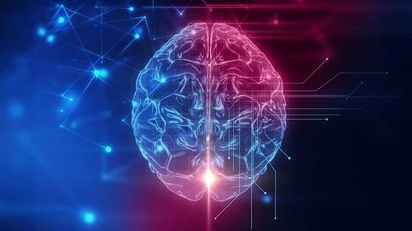
MODULE 5 New Methods & Practices
5.3. Neuroscience in VET

Slide 2
WHAT IS NEUROSCIENCE?
At its most basic, neuroscience is the study of the nervous system – from structure to function, development to degeneration, in health and in disease. It covers the whole nervous system, with a primary focus on the brain. Incredibly complex, our brains define who we are and what we do.

Slide 3
What is educational neuroscience?
“Education is about enhancing learning, and neuroscience is about understanding the mental processes involved in learning. This common ground suggests a future in which educational practice can be transformed by science, just as medical practice was transformed by science about a century ago.” – Report by the Royal Society, UK, 2011
Notes:
Educational neuroscience is usually described as follows:
Educational neuroscience (or neuroeducation, a component of Mind Brain and Education) is an emerging scientific field that brings together researchers in cognitive neuroscience, developmental cognitive neuroscience, educational psychology, educational technology, education theory and other related disciplines to explore the interactions between biological processes and education.
Researchers in educational neuroscience investigate the neural mechanisms of reading, numerical cognition, attention and their attendant difficulties including dyslexia, dyscalculia and ADHD as they relate to education.
Researchers in this area may link basic findings in cognitive neuroscience with educational technology to help in curriculum implementation.The aim of educational neuroscience is to generate basic and applied research that will provide a new transdisciplinary account of learning and teaching, which is capable of informing education.

Slide 4
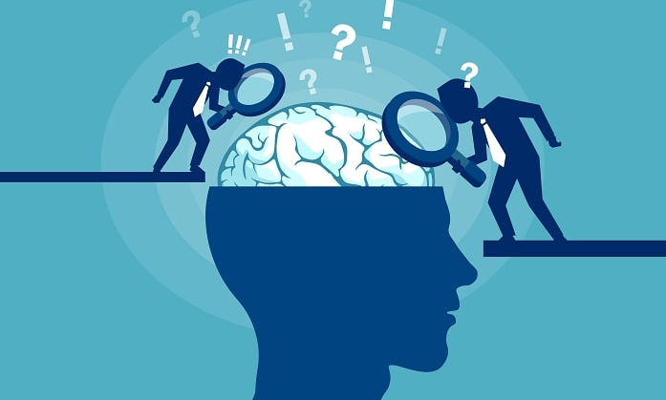
Neuroscience & Adult Learning
Notes:
As adult learners now make up the majority of VET trainees, it is more important than ever for educators who administer and teach in post-traditional programs to understand how the adult brain learns. So we will examine the science of how the adult brain learns and offer suggestions for faculty in post-traditional programs to capitalize on this knowledge and maximize the effectiveness of their teaching. Both theoretical underpinnings and practical tips for brain-based teaching will be offered.

Slide 5
Notes:
Let us begin by asking ourselves as trainers, “How many of us in here genuinely care that our trainees learn?” Of course, we care that our trainees learn; that’s why we do what we do! But how do we know learning is actually taking place? Many instructors simply do what they have done for years, or they do what feels right, or they choose an activity that they read about or saw somewhere. But if we genuinely care that our students learn, then it behoves us to make informed choices about our instructional strategies so we can rest assured learning is taking place.

Slide 6
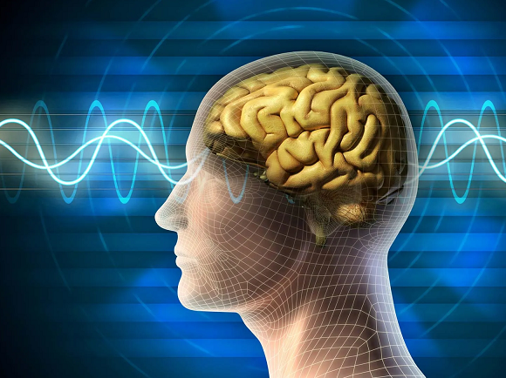
How does the adult brain learn?
Notes:
Adult learners bring a wealth of knowledge and life experiences to the learning process, making it dynamic and unique. They are motivated by specific goals and seek practical and applicable knowledge. Adult learners usually prefer self-directed and problem centered learning, where they can actively engage with the content and apply it to real-life situations.
By understanding the nature of adult learners and leveraging the principles of neuroscience, we can design effective learning strategies that cater to their specific needs.

Slide 7
Let's explore how Neuroscience can enhance the adult learning journey:
Emotion and Attention: The Gateway to Engagement
“Emotion is the fast lane to the brain, and the attention in the toll booth”- John Medina
Notes:
Neuroscience research reveals that when learners are emotionally engaged and their attention is captured, they become more receptive to acquiring new knowledge and skills. Emotion acts as a catalyst accelerating the learning process by activating brain’s reward and motivation systems. Attention on the other hand acts as a gateway, filtering and prioritizing information for processing and encoding in memory.
“Emotion is the fast lane to the brain, and the attention in the toll booth”- John Medina. John is a molecular biologist and the author of “Brain Rules”. He emphasizes the importance of emotional engagement and attention in the adult learning process that also reinforces on the neuroscience research stated above.
Emotions and attention are intertwined in the learning process. Emotionally engaged and attentive audience are more receptive to new knowledge and skills.

Slide 8
Emotion and Attention: The Gateway to Engagement
Start sessions with compelling stories or personal anecdotes that resonates with learners and evokes emotional responses thereby building connection to the content.
Incorporate moments of surprise, curiosity, or novelty throughout the learning experience to sustain learners' attention and curiosity.
Notes:
Here are some steps that can be adopted during the learning process:
Start sessions with compelling stories or personal anecdotes that resonates with learners and evokes emotional responses thereby building connection to the content.
Incorporate moments of surprise, curiosity, or novelty throughout the learning experience to sustain learners' attention and curiosity.
Connect with learners' emotions and create an engaging learning atmosphere to fuel their curiosity and motivation.

Slide 9
Spaced repetitions: Reinforcing the foundation
“Repetition is the key to learning, and spaced repetition is the key to remembering" - Patrick Allan.
Notes:
According to Neuroscience principles, human brains are wired to optimize memory retention through strategic spacing of repeated exposure to information. When we review key concepts at specific intervals, it enhances the process of memory consolidation and strengthens neural connections. This phenomenon known as the spacing effect takes advantage of the brain’s ability to encode and store information more effectively over time.
“Repetition is the key to learning, and spaced repetition is the key to remembering" - Patrick Allan. He highlights the importance of spaced repetition in the learning process. The quote underscores the idea that repetition alone is not enough; it is the strategic spacing of repetitions that enhances memory and retention. By incorporating spaced repetition techniques into learning experiences, we can optimize the learning process and improve long-term recall.

Slide 10
Spaced repetitions: Reinforcing the foundation
Here are some steps that can be adopted by Learning Designers:
Break down learning content into bite-sized modules or topics that allows learners to focus on one concept a time.
Schedule regular review sessions or spaced practice activities to reinforce on previously learned information and strengthen memory recall.
Integrate different forms of repetition, such as quizzes, flashcards, or interactive exercises to engage learners actively in the review process.

Slide 11
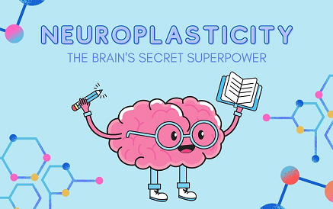
Neuroplasticity: The Power of Adaptability
"Our brains possess an incredible quality known as neuroplasticity. No matter our age, we have the ability to learn, develop new skills, and adapt to new environments." - Norman Doidge
Notes:
"Our brains possess an incredible quality known as neuroplasticity. No matter our age, we have the ability to learn, develop new skills, and adapt to new environments." - Norman Doidge. Norman Doidge highlights the transformative power of neuroplasticity in adult learning. Neuroplasticity allows adults to tap into their established neural networks and rewire their brains for learning, growth, and adaptation. Unlike children whose brains are naturally primed for rapid development, adults can consciously leverage neuroplasticity to acquire new knowledge and skills, embrace change, and navigate complex challenges.
By recognizing the power of neuroplasticity, we can design learning experiences that optimize the adult learning advantage and unlock their true potential.

Slide 12
Neuroplasticity: The Power of Adaptability
Here are some steps that can be adopted by Learning Designers:
Incorporate interactive activities, such as quizzes, discussions, or hands-on exercises, to actively engage learners and stimulate their cognitive abilities.
Provide opportunities for learners to practice and apply newly acquired skills in real-life scenarios, encouraging them to explore different approaches and solutions.
Offer continuous feedback and reinforcement to support the growth and adaptation of learners' neural connections.
Design learning experiences that challenge learners and facilitate the formation of new neural connections.

Slide 13
Active Learning and Application: Making Knowledge Meaningful
Neuroscience research highlights that active engagement stimulates brain’s neural networks by promoting the formation of new connections and reinforcing the existing ones. When learners actively participate, solve problems, and apply their knowledge in practical scenarios, it activates multiple regions of the brain associated with memory, comprehension, and higher order thinking.
Notes:
Neuroscience research highlights that active engagement stimulates brain’s neural networks by promoting the formation of new connections and reinforcing the existing ones. When learners actively participate, solve problems, and apply their knowledge in practical scenarios, it activates multiple regions of the brain associated with memory, comprehension, and higher order thinking. This multi-dimensional engagement facilitates deeper understanding, long-term retention, and transfer of knowledge to real-world contexts.
By designing interactive activities, we can leverage the brain’s natural propensity for active engagement and enhance learning outcomes.

Slide 14
Active Learning and Application: Making Knowledge Meaningful
Here are some steps that can be adopted during the learning process:
Facilitate discussions, debates, or peer-to-peer interactions to encourage active participation and exchange of ideas.
Provide opportunities for learners to apply their knowledge in practical situations, through role-plays, virtual scenarios, or on-the-job assignments.

Slide 15
Multi-Sensory Learning: Engaging the Whole Mind
“Engaging multiple senses in the learning process is like turning on all the lights in a room. It illuminates the subject matter from every angle, allowing learners to see, hear and feel the knowledge, creating a deeper and more impactful learning experience”- John Ratey.
Notes:
“Engaging multiple senses in the learning process is like turning on all the lights in a room. It illuminates the subject matter from every angle, allowing learners to see, hear and feel the knowledge, creating a deeper and more impactful learning experience”- John Ratey.
Our brains are wired to process information through multiple sensory channels including visual, auditory, and tactile. By incorporating visuals, auditory cues, and interactive experiences, we tap into the brain’s natural ability to process and retain information more effectively. Neurosciences studies indicate that engaging multiple senses during learning creates a richer and more immersive experience, allowing learners to make meaningful connections and enhance their overall comprehension and retention of the subject matter.

Slide 16
Multi-Sensory Learning: Engaging the Whole Mind
Here are some steps that can be adopted by Learning Designers:
Use diverse multimedia resources: Incorporate videos, infographics, and podcasts to engage- different senses and accommodate various learning preferences.
Integrate interactive elements: Include clickable diagrams, simulations, and virtual reality experiences to actively engage learners and enhance information comprehension and retention.
Emphasize hands-on activities: Provide opportunities for learners to engage their senses through demonstrations experiment, and experiential learning reinforcing understanding and knowledge application.

Slide 17
Neuroscience in VET
In conclusion, the intersection of adult learning and Neuroscience provides us with valuable insights and strategies to create impactful learning experiences. By understanding the unique characteristics of adult learners and harnessing the power of emotion, attention, neuroplasticity, spaced repetition, active learning and multi-sensory experiences, we can unlock their true potential. Principles of Brain Sciences to design learning programs empowers adults to acquire new knowledge, develop skills, and adapt to new challenges.

Slide 18
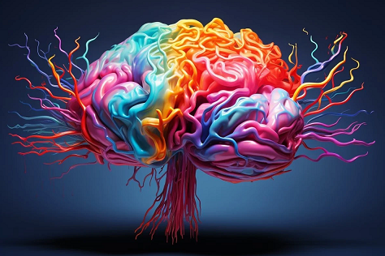
MODULE 5 New Methods & Practices
THANK YOU!

